Slide 1


UNIVERSIDAD AUTÓNOMA DEL ESTADO DE HIDALGO
ESCUELA SUPERIOR DE ZIMAPÁN
Licenciatura en Derecho
Logros y experiencias. Lengua extranjera.
L.E.L.I. Paulina Trujillo Castillo
Enero – Junio 2016

Slide 2
Resumen (abstract):
Ésta presentación indica en que momento y con qué verbos es posible utilizar la forma del gerundio o el infinitivo.
(This presentation indicates when and which verbs can be used with the –ing ending or infinitives.)
Palabras claves en idioma (keywords):
Verb, infinitive, infinitive with to.

Slide 3
Objetivo general:
El alumno podrá entender y compartir información acerca de experiencias, eventos pasados que continúan en el presente y la duración de eventos.

Slide 4
Nombre de la unidad:
2. Planear proyectos futuros
Objetivo de la unidad:
Entender y realizar de manera oral y escrita planes de proyectos futuros así como compromisos, posibilidad, y gustos y preferencias con referencia al futuro.

Slide 5
Tema:
1. 1. Describir rutinas y estados temporales.
Introducción:
When can I use a verb in infinitive, a verb in infinitive with to or a verb with the –ing ending?
This is a common questions when we are studying english, maybe because in spanish they are transalated with the same structure, so they usually use verbs in infinitive with to.
Unfortunately, there is no other way to learn this, but memorizing. In the next slides, you will see some rules to use these verbs correctly.

Slide 6

Desarrollo del tema:
When we use two verbs together, the form of the second verb depends on the first one. This is what we called a verb pattern, and they indicate us, when to use verbs in infinitive, in infinitive with to or verbs with the –ing ending.

Slide 7



Verbs in infinitive with to
We use verbs in infinitive after some verbs such as: would like, agree, decide, choose, plan, refuse, hope, want, manage, etc. For example:

Slide 8



You can also use a verb in infinitive with to, after some adjectives. For example:

Slide 9


To express the reason why we are doing something.

Slide 10

This is an important note:
The negative form of the infinitive is: not + infinitive. Example:

Slide 11
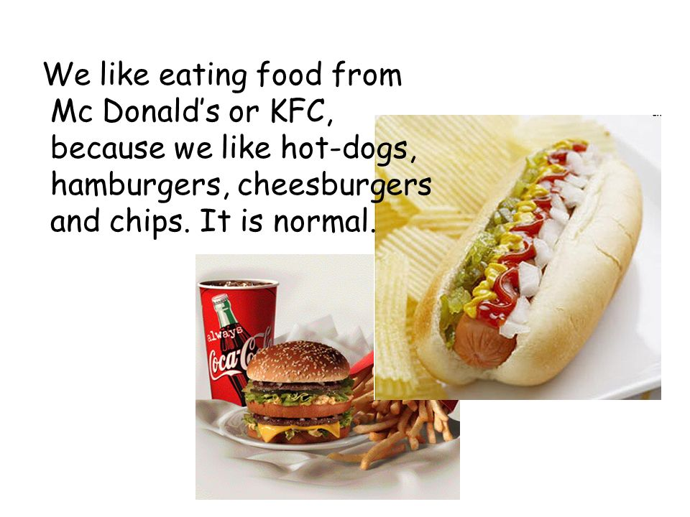

Verbs with the –ing ending
It is used after some verbs, for example: deny, avoid, can’t help, like, dislike, enjoy, mind, keep on, suggest, finish etc.

Slide 12
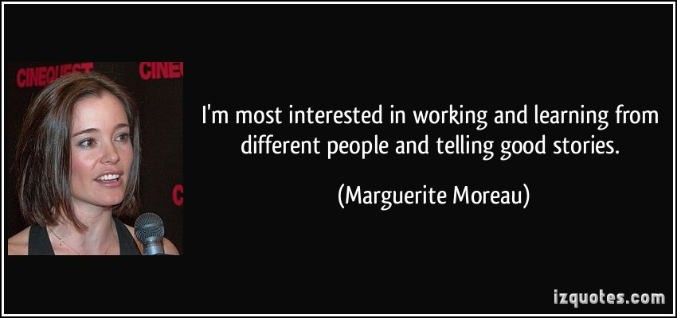
After prepositions.
Tip! In this rule it is included the following phrase usually used at the end of an email or a letter. Example: I’m looking forward to hearing from you soon. Because in this case, to, is a preposition.

Slide 13


When the verb is the subject of a sentence.

Slide 14

This is an important note:
The negative form of the gerund is “not + verb -ing”. Example:

Slide 15
Conclusions:
There no other way to learn how to use these infinitives or gerunds, but memorize them according to the rules. There are even some books which give you tables to indicate when to use the correctly.

Slide 16
Bibliografía sugerida para el tema:
Paul Davies, M. G. (2014). Make it real! Professional. Pachuca: UAEH University Press.
Redston, C. Cunningham, G. (2005). Face2Face Elementary Student’s Book. Cambridge, London. Cambridge University Press.

